Slide 1
Reconstruction of 3D Neuronal Structures
Presentation By :
Kanuj Kumar
Master of Science (Engineering)
Visualization And Graphics Lab
Indian Institute of Science

Slide 2
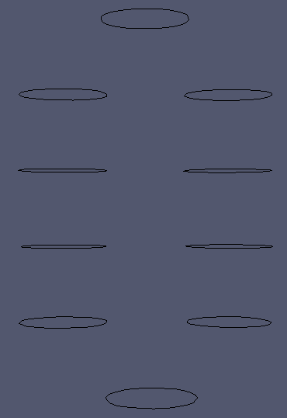
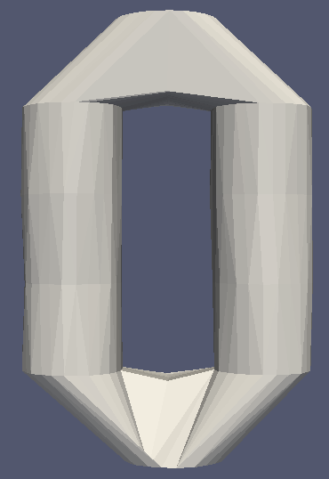
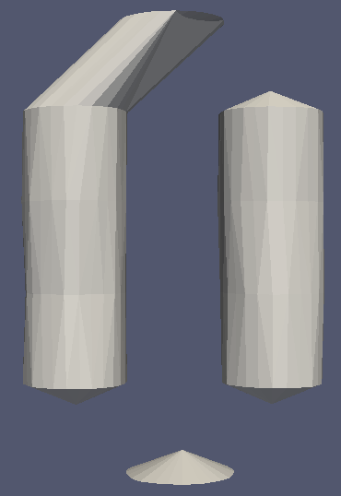
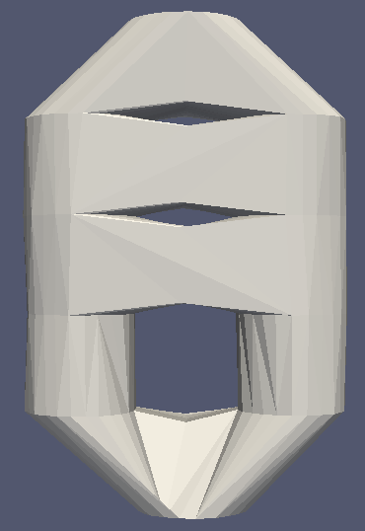
What is 3D Reconstruction?

Slide 3
How do we obtain input?
The confocal microscope
Detector
(Photo Multiplier)
Detection Pinhole
Emission light
Tube lens
Excitation Pinhole
Laser
Scanning Mirror
Excitation light
Stack of 2D Images
Objective lens
Specimen
Focal Plane
Notes:
The key feature of this imaging technique is its ability to acquire in-focus images from selected depths. Light is gathered confocally using a spatial pinhole, which filters the photons coming from out of focal plane.

Slide 4
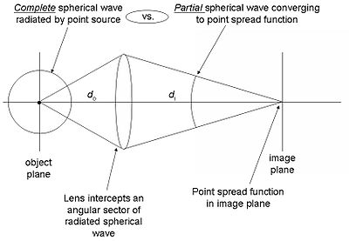
The Point Spread Function (PSF)
XY plane
XZ plane
YZ plane
Image Courtesy : Kalyan and Dr. S. K. Sikdar
Notes:
PSF is a system's impulse response, t
fluorescent beads are usually considered for this purpose

Slide 5
Sample Deconvolved Dataset
Image Courtesy: Kalyan and Dr. S. K. Sikdar
Deconvolution done with Huygens softwareTM

Slide 6
3D Reconstruction of Neurons
Why?
  facilitates visualization of the anatomical relationships of neurons and their patterns of dendritic and axonal contacts
  provides anatomical data for construction of electrical and biochemical circuit models of neuron function that can be used in further computer simulations.

Slide 7
3D Reconstruction of Neurons
Challenges involved
  diffraction effects causing a spread of a point object in the image characterized by the point spread function.
  variable contrast due to uneven dye distribution within the cell causing apparent discontinuity in structures.
  many features of interest (such as thin dendrites) are at the limit of imaging resolution.
  Partial volume effect dependent of PSF

Slide 8
Existing approaches
Limitations
  Manual
    Requires a lot of user time investment or precision to extract boundaries, spot seed points
    Example commercial systems such as Neurolucida, Neurozoom, Meijring et al. (selection of ambiguities)
  Automated
    Dependent on resolution, size, contrast of data
      Zhao et al (contrast), Fua et al (size), Hamilton et al.(size), Urban et al. (resolution), Schmitt et al.(resolution)
    Center-line based methods: Al-kohafi et al., Zhao et al.
    Boundary based methods: Schmitt et al.
Notes:
Automated tools capable of resolving neuronal morphology on both local and global scales, and with suﬃcient automation, are limited by the skeletonisation methods used, and by quantization errors arising from insuﬃcient imaging resolution.

Slide 9
Problem definition
suﬃcient accuracy of the reconstructed model can be accomplished
topological constraints based on the assumption of a treelike structure must be fulﬁlled
the amount of the user’s time and eﬀort should be reasonably small
allow user intervention to correct any unsatisfactory outputs
should be fast and make eﬃcient use of memory

Slide 10
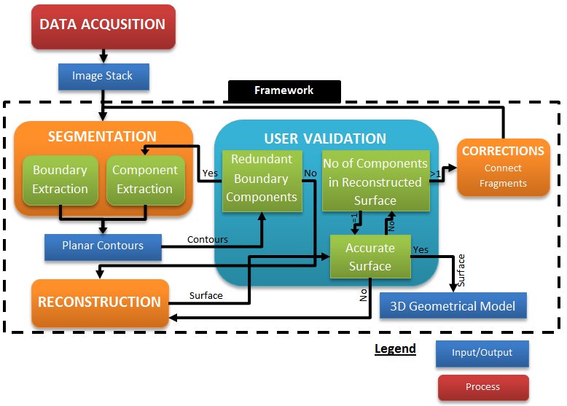
The Framework
Notes:
A primary goal of our approach is the development of an automated system for accurate 3D reconstruction of neuron morphology, capable of handling input data independent of the scale of the images. As we place emphasis on our framework to create ﬂexible models, experience of the human anatomist becomes necessity to validate the output of process in the framework. However, in contrast to standard manual reconstruction techniques, we kept the requirement of minimal user assistance to reconstruct the model.
The ﬁrst processing module is the segmentation, which is used to extract representative boundary of neurite structures from the given image data. Surface is then generated in the reconstruction module from the segmented structures. In our framework, an automated pipeline can also be deduced by initializing the parameters,
Uses local neighbourhood for achieving faster computation time and uses global scale to eleminate noise wherever necessary.
The segmentation module starts with computation of boundary poly-
gons based on locally adapted thresholds for an image. A connected 3D component is
then formed to ﬁlter the noisy structures that employs global connectivity among bound-
ary polygons. The choice of input parameters is assisted via immediate visualization of
results from the process.
Reconstruction The goal of the reconstruction module is to ﬁnd a best surface consis-
tent with the extracted polygons. In our framework, the reconstruction module attempts
this construction of triangulation from the boundary polygons. This triangulation is ex-
tended further to create correspondence between polygons of adjacent slices. The general
principles that guides the volumetric reconstruction algorithm are described in section
2.5.1.
Corrections The goal of the correction module is to produce a connected structure
when the reconstruction module is unable to do the same. In order to achieve this, we
build a set of minimum-spanning-tree (MST) over the polygons in diﬀerent connected
components and then establish a link between polygons if the corresponding pair is
connected by an edge in the MST.

Slide 11
Segmentation
Binary Conversion
Parallel
Closing of holes and removal of small islands
Parallel
Boundary Tracing
Removal of spatially distant boundary structures
Notes:
Binary conversion is done through simple thresholding due to its least computation time.
Histogram based – consider peaks, or valleys
Clustering based – design an guassian model using grasl intensies.
Show visual tool demo
Spatial based – uses correlation b/w pixel nieghbourhood

Slide 12
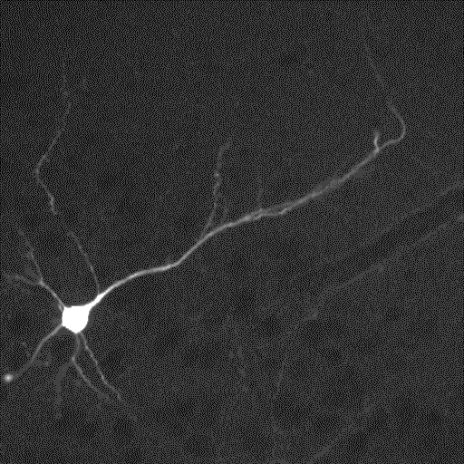
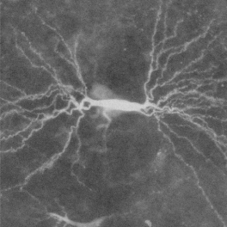
Dataset
Notes:
we have acquired following datasets recorded with confocal microscopy where each dataset consists of artifacts or noise inherent from the mechanism of how it was obtained.
This dataset shows the subicular pyramidal neuron cells from
rat hippocampi. Images were acquired with through CLSM loaded with calcium stained
dye. The dataset consists of 47 steps with voxel resolution of 0.65 µm in the x-y axis and
0.5 µm in the z axis. Excitation wavelength was set to 488 nm with index of refraction
corresponding to that of the water. The depth of image is 8 bits/pixel with resolution
of 512x512 in x-y scale.
Dataset II[Figure 2.1b]: This dataset shows the CA3 pyramidal neuron from the rat
Chapter 2. Basic Concepts 9
hippocampo. Images were acquired with CLSM loaded with Diaminobenzidine dye. The
dataset consists of 36 steps with voxel resolution of 1.0 µm in the z axis. In this dataset,
dendrites project in all directions from the soma, generally having wider apical segments
that taper with distance from the soma. The axon is not visualized in this image.

Slide 13
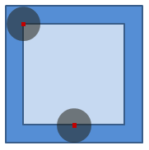
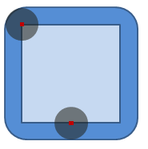
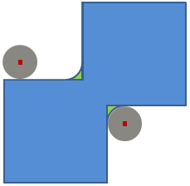
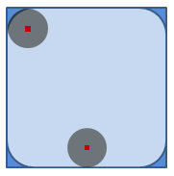
Morphological Operations
Erosion
Dilation
Opening
Closing
Notes:
Erosion : outer square eroded to light blue inner square
Dilation: inner square dilated to outer blue square
Opening: e+d = outer square opened to rounder square
Closing: d+e = two squares closed to curve shaped union.

Slide 14
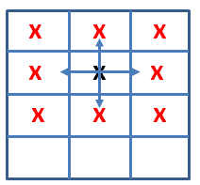
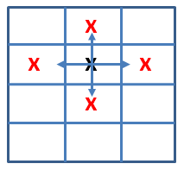
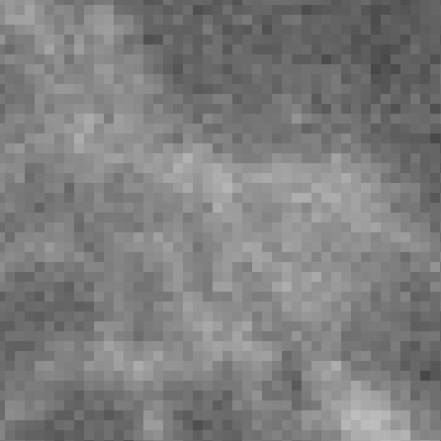
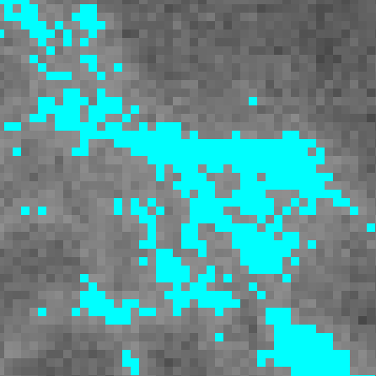
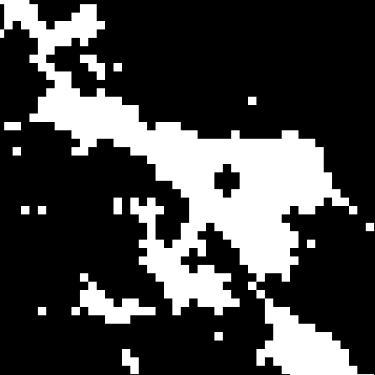

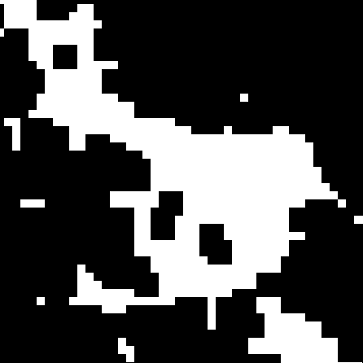
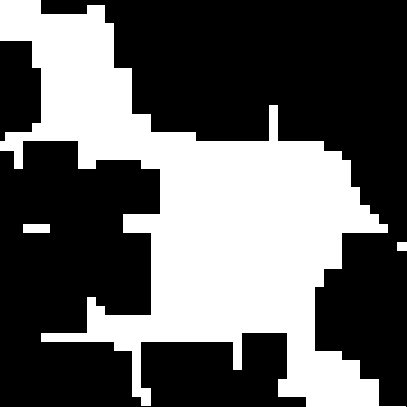
Morphological Operations
Neighborhood Templates
(A)
(B)
(C)
(D)
(E)
(F)
Notes:
Moore neighborhood
Von neumann neighborhood

Slide 15
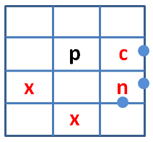
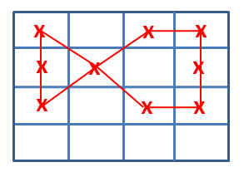
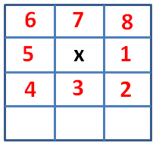
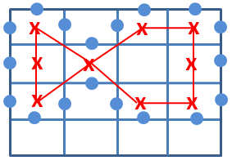
Contour Extraction
Traversal Order
Path Template
An example of
special case
X
X
X
X
X
Notes:
Kind of like adaptation of Moore-Neighbor Tracing Algorithm
Able to trace both convex an non convex polygon boundaries.
scan top to bottom and left to right, we check neighbour of pixel in order
Terminating condition first pixel
Few corner cases are also handled
Path templates have been designed to ensure boundary pixels are single pixel wide

Slide 16
Component Extraction
(noise removal)
$${dis}_{g}\left(c_{i,}{ c}_{j}\right)=min\left(dis\left(v_{p}, v_{q}\right) ∀ v_{p}{∈c}_{i}, v_{q}∈c_{j}\right)<t_{0}$$
Notes:
We take geodesic distance as the measure two compute spatially distant contours and compute components based on given threshold.

Slide 17
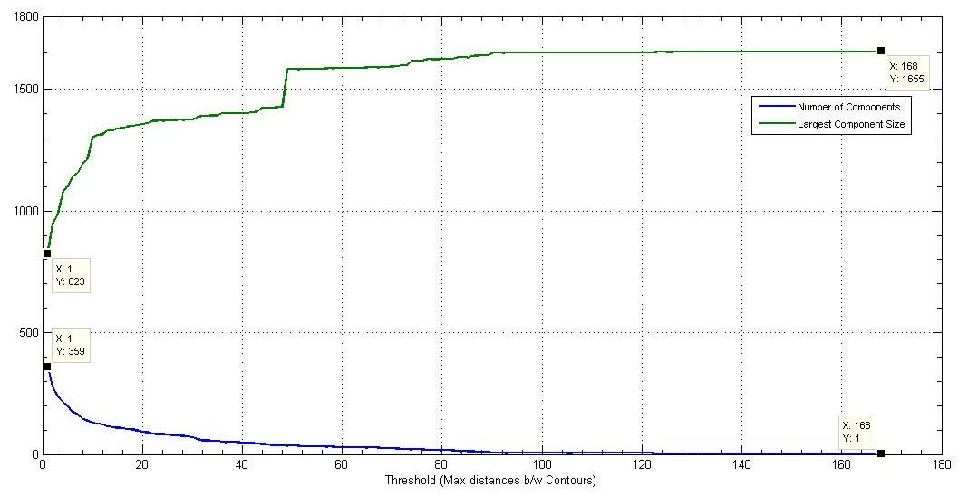
Component Extraction
$${dis}_{g}\left(c_{i,}{ c}_{j}\right)=min\left(dis\left(v_{p}, v_{q}\right) ∀ v_{p}{∈C}_{i}, v_{q}∈c_{j}\right)$$
Notes:
User can either extract largest component of multiple components
User can also visualize the result in realtime for different thresholds.

Slide 18
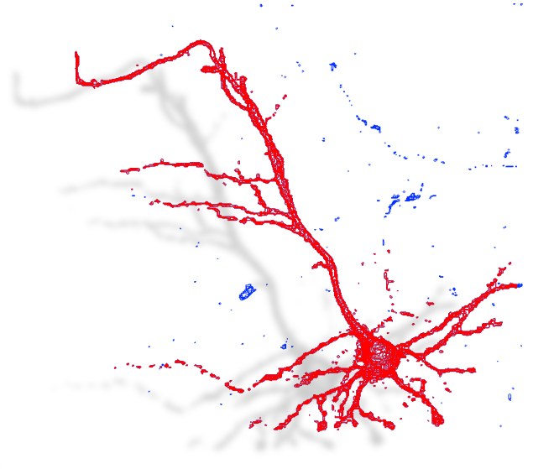
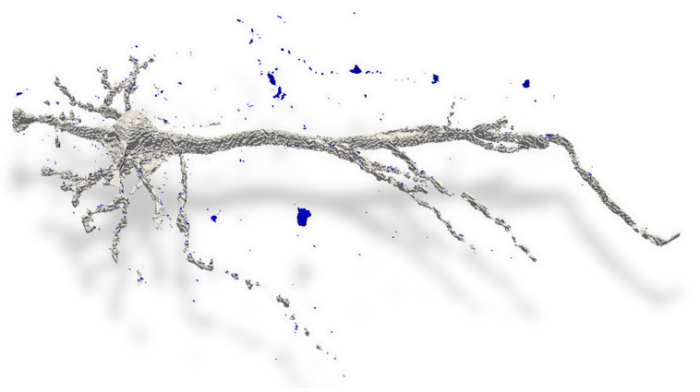
Component Extraction

Slide 19
Volumetric Reconstruction
3D Delaunay Triangulation
Parallel
Parallel
Adaption of 𝛽-Connection Algorithm
Combine mesh
Notes:
Conformity condition all edges of contours are in reconstructed object : ensuerd boundary doesn’t interect contours
Manifold condition boundary is locally everwhe a toplogical disk : forbids zero or one dimensional features

Slide 20
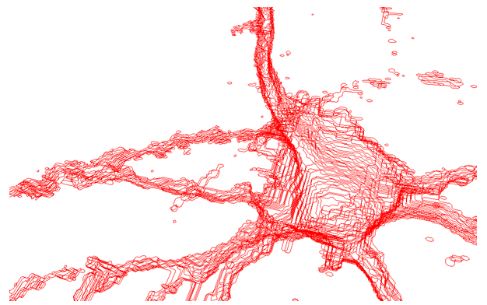
Arrangement of Input Data for Reconstruction
Non Intersecting and oriented Contours
Notes:
Structure lies to the right of contour
All internal contours are oriented counter-clockwise and extern al counters clockwise

Slide 21
Delaunay Triangulation – Implementation Algorithm
2D Delaunay Triangulation
Verify Edges
Parallel
Parallel
Contour Classification
3D Delaunay Triangulation
Notes:
Faster compuatation using 2d to verify
Mention boissioat property 3d dt intersection with a plane is 2D DT
Edges can be subdivided to to be contained in triangulation.

Slide 22
Strong Overlapping Regions
Boissonat’s Version
Nonato’s Version
Overlapping Voronoi Skeleton
Presence of reverse tetrahedron in DT
Notes:
A disntace measue can be derived from dt itself
Bound to be connected with beta = 1

Slide 23
Strong Overlapping Regions
Delaunay Edges
Voronoi Edges
v₂
d₂
S
v₁
v₂
d₁
a
p
p
C
Overlapping Voronoi Skeleton
Notes:
Note that the center of S belongs to the line defined by the points in v1 and v2 that project onto the point a.
S does not contain any other point of C1 or C2 in its interior.
In fact, suppose that there is a point p in P1 (or P2) inside S, this point must be inside of the circle C generated by the intersection between S and P1.
But the center of this circle belongs to v1 (v2) and any circle with center in v1 (v2) containing the ends of d1 does not have any other point
in its interior, then p can not be inside S and (d1, d2) defines the reverse tetrahedron in the Delaunay triangulation.

Slide 24

Why $β$-Connection
Independent of number of contours in the slices, their geometries, or their containment hierarchies
capable of generating multiple alternatives when establishing region correspondence
intrinsically handles tiling and branching problem
reconstructed object is a manifold
enables a more robust and efficient implementation
Notes:
Manifold : deals with the topological singularities that may appear during the process of reconstruction
Roubst: all the operations in the reconstruction process are combinatorial or topological

Slide 25

$β$-Connection Algorithm (Nonato et al)
Tetrahedron Classification
𝛽-Components Calculation
Parallel
Parallel
Inter-Component Disconnection
Intra-Component Disconnection

Slide 26
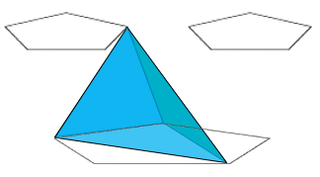
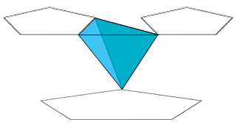
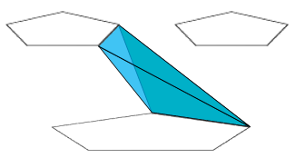
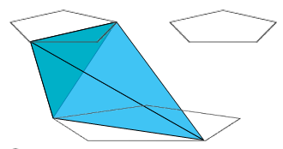
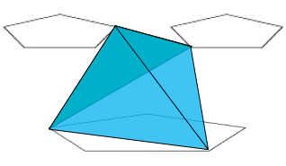
Tetrahedron Classification
Type I
Type II
Internal
External
Redundant
Reverse Internal
Reverse External

Slide 27
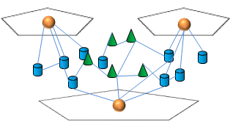
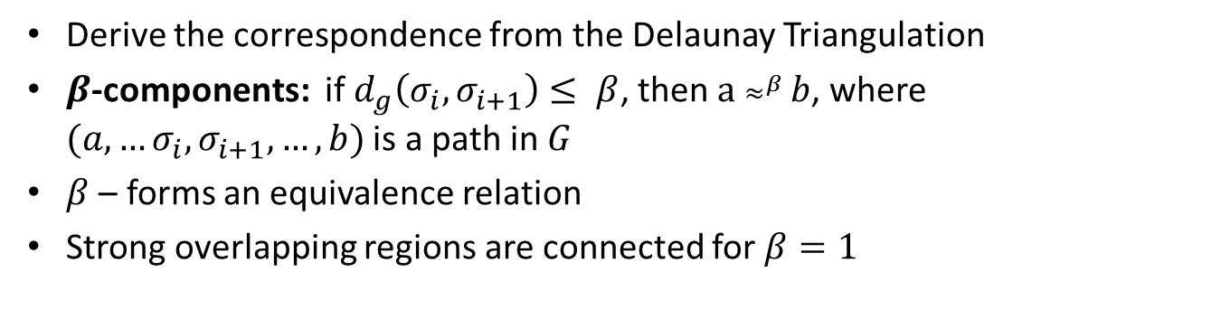
The DT-Associated graph
Derive the correspondence from the Delaunay Triangulation
$β$-components: if $d_{g}\left(σ_{i},σ_{i+1}\right)≤ β$, then $a ≈^{β} b$, where $(a, …σ_{i},σ_{i+1},…,b)$ is a path in $G$
$β$ – forms an equivalence relation
Strong overlapping regions are connected for $β=1$
Notes:
The graph G is a connected graph as all regions nodes of $G$ contain tetrahedron that either share a face to another tetrahedron or contain face in another region node.
A path of length n connecting two region nodes $a$ and $b$ in $G$ is a sequence of nodes $τ_{1},…,τ_{n+1}$ such that $τ_{1}=a$ , $τ_{n+1}=b$ and ($τ_{i}$, $τ_{i+1}$), $i = 1,…,n,$ is an edge of G. The distance between two region nodes $a$ and $b$, denoted $d_{G} \left(a, b\right)$ is the length of the shortest path between $a$ and $b$.
Varying $β$ allows different correspondence

Slide 28
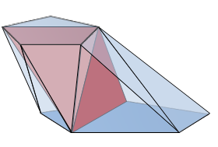
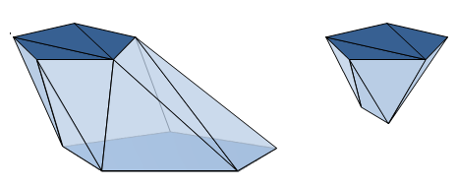
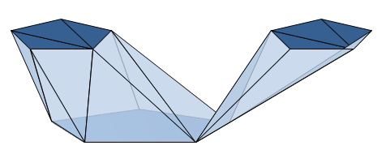
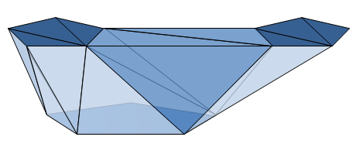
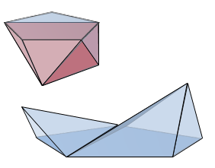
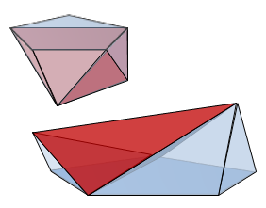
Inter-Component Disconnection
Notes:
Removal of external and redundant tetrahedra whose are in differnet components
We traverse the internal tetrahedrons incident on vertices of removed tetrahedron and check if belongs to two different components.
Right: special case beta = 0 duplicate the reverse tetrahedron

Slide 29
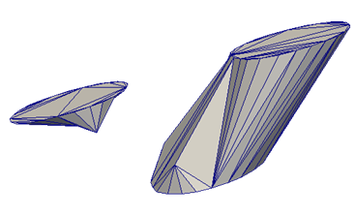
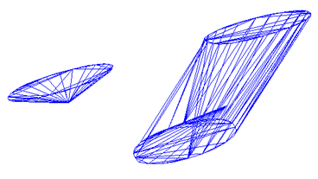

Vertex Displacement
Generates Intersection
Centroid of Contours – $β$-connection
Centroid of Tetrahedrons that are being displaced

Slide 30
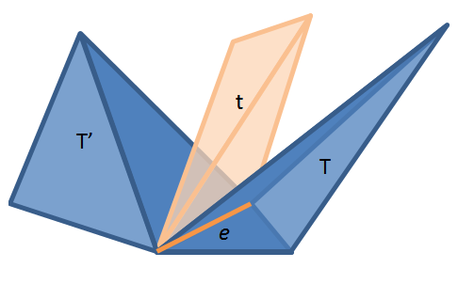
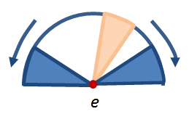
Manifold – Avoiding singularity
Manifold - a bounded compact set whose boundary is locally everywhere a topological disk.
Notes:
A topological space X is called locally Euclidean if there is a non-negative integer n such that every point in X has a neighborhood which is homeomorphic to the Euclidean space E^{n} (or, equivalently, to some connected open subset of E^{n}).
A topological manifold is a locally Euclidean Hausdorff space. (Hausdorff space, separated space or T₂ space is a topological space in which distinct points have disjoint neighbourhoods.)
An n-manifold will mean a topological manifold such that every point has a neighborhood homeomorphic to R^{n}.(eucldeian space)
Examples
Euclidean space R^{n} is the prototypical n-manifold.
Any discrete space is a 0-dimensional manifold.
A circle is a 1-manifold.
A torus is a 2-manifold (or surface) as is the Klein bottle.
Face to face connectivity : there exists a sequence of tetrahedra $T = T_{0}, …, T_{k} = T’$such that for all $i, { T}_{i} ∈ K,$ and $(T_{i}{,T}_{i+1})$share a face.
An edge e is singular if any tetrahedron in star of e is not face-to-face connected in K to at least one tetrahedron incident to e.
Tetrahedron t incident to e is disconnected if it can be visited twice with different directions or if it does not shares both of its faces containing e.

Slide 31
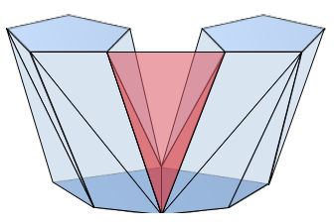
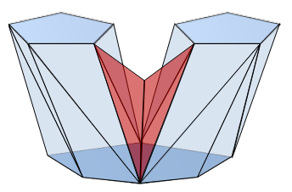
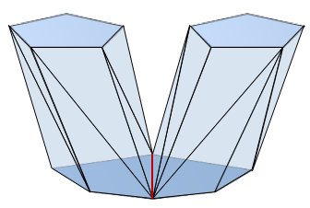
Intra-Component Disconnection
Notes:
To ensure the manifold condition, tetra are subdivided and translated based on predefined classification

Slide 32
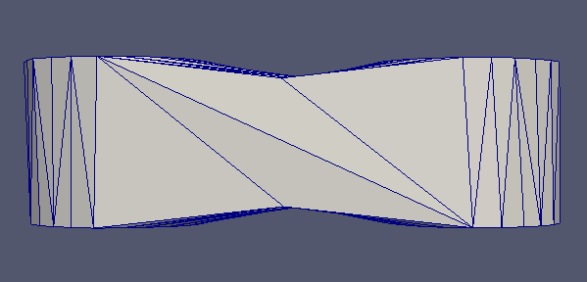
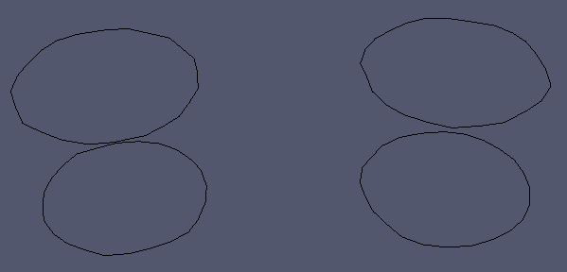
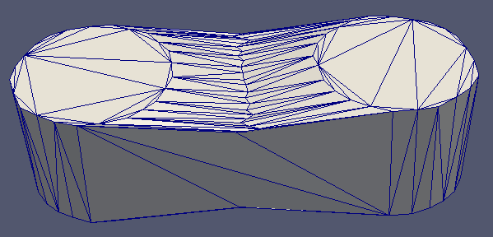


Branching Problem
Notes:
nonato we observed the branching was not adapted to suit the neuron reconstruction.

Slide 33


Intra-component Disconnection
The Disconnection algorithm
Notes:
Subdivide the edges and disconnect the external and redundant tetrahedral whose elimination singularties.
We disconnect the tetrahedra based on the orientation of edges
Type1 with 1e(external edge bd): divide along external edges and translate
Type1 with 2e(two external edges cb and bd): divide along in-section and external edges
Type1 with 3e: same as type 2
Type2(external edges da and cb): subdivide along all edges
Redundant: same as type 1 with 2e: s
Disconnection algo also confirms to manifold condtion since it respect the contours(doesn’t divide along contour edge), neighbouthood around the edge always remain the same

Slide 34



Avoid branching with disconnection algorithm
Notes:
disconnection process respects the contours (i.e. the subdivided tetrahedron always contain its contour edges), the neighbourhood around the edge is always maintained, guaranteeing the manifold condition.
In order to enforce the resampling condition, we can also translate the new points inserted in the subdivision to an intermediate position between the parallel planes, however this may not be necessary in terms of reconstruction of neuron structures.

Slide 35

Necessity of Corrections Module
Notes:
Contours are spatially distant in 3D space and not sufficient to be connected with given beta value.

Slide 36
Corrections Module
$${dis}_{g}\left(c_{i,}{ c}_{j}\right)=min\left(dis\left(v_{p}, v_{q}\right) ∀ v_{p}{∈c}_{i}, v_{q}∈c_{j}\right)≤1$$
Notes:
We compute MST of the components and determine the set of contours to be merged. We again use geodesic distance as the measure for each component as well as contour.
We first build a graph with contours as nodes and edge b/w them if their geodesic distance is less than 1 and then compute the components in the graph.

Slide 37
Corrections Module
$${lab}_{g}\left({Co}_{j,}{ Co}_{k}\right)=min\left({dis}_{g}\left(c_{p}, c_{q}\right) ∀ c_{p}{∈Co}_{j}∩S_{i},∀ c_{q}{∈Co}_{k}∩S_{i};i=1,…,k\right)≤t_{1}$$
Notes:
We use these components as nodes to build another graph with edges b/w two nodes if geodesic distance b/w contours of components is less than given threshold.
Finally we compute the MST on the filtered graph, so that components spatially near to each other are connected.
We merge the contours of MST by connecting their shortest vertices.
The output of the corrections module is again fed to segmentation module for boundary extraction.

Slide 38

Corrections Module
$${lab}_{g}\left({Co}_{j,}{ Co}_{k}\right)=min\left({dis}_{g}\left(c_{p}, c_{q}\right) ∀ c_{p}{∈Co}_{j}∩S_{i},∀ c_{q}{∈Co}_{k}∩S_{i};i=1,…,k\right)≤t_{1}$$

Slide 39


Results from Corrections Module

Slide 40
Data Structure – Half Edge
efficient implementation
combinatorial operations like “update of neighborhood” can be done in linear time
Notes:
It optimizes the memory consumption / execution time ratio for diﬀerent topological operations in reconstruction process.
The adjacency relationships among half-faces are also stored where each half-face knows the adjacent half-face in the neighbor cell
each half-face consists of circular lists of its half-edges to deﬁne its orientation.
This half-edges can either be oriented clockwise or counter-clockwise around the face based on the orientation of overall mesh.

Slide 41




Complexity and Performance of the Framework
(Tested on Intel Xeon Quad Core, HP xw6600 Workstation)
Segmentation |  |  | Linear | Parallel
Thresholding |  | $$O(zp)$$ | 3.760 | 2.153
Morphological Operations |  | $$O(zp)$$ | 3.682 | 2.715
Boundary Extraction |  | $$O(zp)$$ | 3.120 | 1.809
Contour Extraction |  | $$O(zp)$$ | 3.900 | 1.982
Component Extraction | Computing Distances | $$O({zn}^{2})$$ | 213.378
 | Building Graph | $$O(zc)$$ | 3.81
 | Extracting Component | $$O(zc)$$ | 1.82
Total |  | $$O({zn}^{2})$$ | 230.35 | 227.667
Correction |  | Linear
Computing distances | $$O({zn}^{2})$$ | 54.366
Building Connections Graph | $$O(zc)$$ | 1.856
Building Component Graph | $$O(C)$$ | 0.07
Computing MST | $$O(ElogC)$$ | 0.05
Rasterized Operation | $$O(zp)$$ | 1.378
Boundary Extraction | $$O(zp)$$ | 4.81
Component Extraction | $$O({zn}^{2})$$ | 81.463
Total | $$O({zn}^{2})$$ | 143.993
Legend
z | number of sections
p | number of pixels in a slice
n | number of vertices in a pair of slices
c | number of contours in a pair of slices
C | number of components in connections graph
N | size of neighborhood of tetrahedron
T | number of tetrahedrons in DT
Reconstruction |  | Linear | Parallel
Computing 3D Delaunay Triangulation | $$O({zn}^{2})$$ | 23.83 | 6.83
Reconstruction of surface | $$O(zNT)$$ | 771.72 | 244.62
Building overall mesh | $$O(z)$$ | 0.967
Total | $$O({zn}^{2})$$ | 796.51 | 252.41
N < z < C < c < n < p < T
Total : 624.06 $≈$ 10 min

Slide 42
Key contribution towards reconstruction of neuron
accurate metrics due to geometric reconstruction rather than compartment model
eliminates subjective estimations and imprecision due to users haste or exhaustion.
minimal user time investment by use of automatic methods, while the user can keep control over the algorithm to generate a flexible reconstruction.
independence from imaging modalities, making it capable of working with varying or discontinuous background intensities, contrast, size, or resolution in images.
introduces a novel approach to handle discontinuities in structures often present in microscopy imagery to produce a connected model.
an accelerated framework capable of processing adjacent pair of images in parallel.
reconstructed mesh is free of singularities which enables the resulting models to be used in simulations without any need for post-processing.

Slide 43
References
Nonato et al, “Beta Connection - Generating a family of models from planar cross sections ”ACM Transaction on Graphics, pp.1239-1258, 2005
J. D. Boissonnat, “Shape reconstruction from planar cross sections”, Computer Vision, Graphics, and Image Processing, pp.1-29, 1988.
Meyers et al, “Surfaces from contours”, ACM Transactions on Graphics, pp.228-258, 1992
Schmitt et al, “New methods for the computer-assisted 3D reconstruction of neurons from confocal image stacks”, NeuroImage, p.1283-1298, 2004.

Slide 44



Framework Pipeline

Slide 45






Framework Pipeline

Slide 46


Validation of Framework (Error Analysis)
Virtual Neuron Model
Reconstructed Mesh
Notes:
To evaluate the reconstruction from our framework, we reconstructed a virtual neuron model and compared the results of reconstruction with the original mesh.
We begin with
computing cross sections
introduced the partial effect of adjacent images by taking average of intensities of pixels in adjacent sections to form a new image.
partial volume effect and intensity decay, we applied the proprietary \Lens blur" eect in Adobe Photoshop
we fed these images to our framework and obtained the reconstructed mesh
Metro uses a mean distance as the measure of approximation error

Slide 47


Validation of Framework (Error Analysis)
Notes:
To evaluate the reconstruction from our framework, we reconstructed a virtual neuron model and compared the results of reconstruction with the original mesh.
We begin with
computing cross sections
introduced the partial effect of adjacent images by taking average of intensities of pixels in adjacent sections to form a new image.
partial volume effect and intensity decay, we applied the proprietary \Lens blur" eect in Adobe Photoshop
we fed these images to our framework and obtained the reconstructed mesh
Metro uses a mean distance as the measure of approximation error

Slide 48

Validation of Framework (Error Analysis)
Results from Metro Tool ^{[1]}
$$E_{m}=\frac{1}{\left|S_{1}\right|}\int_{S_{1}}{e\left(p,S_{2}\right)}ds$$
Approximation Error
Comparisom | Mean Distance | RMS Distance | Percentage Error
Forward | 2.41 | 3.20 | 0.4
Backward | 2.55 | 3.08 | 0.4
[1] “Metro:measuring error on simplified surfaces", Technical Note (Short contribution), Istituto per l'Elaborazione dell'Informazione - Consiglio Nazionale delle Ricerche, Pisa, Italy, 1998.
Notes:
The surface of the rst
mesh is sampled, and for each elementary surface point, distance to the second mesh is
computed. Surface sampling in Metro is achieved by scanning of triangular faces with a
user-selected sampling resolution.

Slide 49
Queries….
A very hearty thanks to Prof. Vijay Natarajan, Dilip, Rahul, Talha and my other my lab-mates for sharing their experience and providing the invaluable support

Slide 50




Deconvolution
Image formation in a confocal microscope
Image Restoration
Grayscale Intensities
Specimen
$$O\left(x,y\right)$$
Image
$$I\left(x,y\right)$$
Deconvolution
PSF
Airy Radius
Image
$$I(x,y)$$
Airy Disk
Notes:
George Biddell Airy. He developed an expression for the point-spread function amplitude and intensity of a perfect instrument, free of aberrations (the so-called Airy disc). The Airy disk (or Airy disc) and Airy pattern are descriptions of the best focused spot of light that a perfect lens with a circular aperture can make. The diffraction pattern resulting from a uniformly-illuminated circular aperture has a bright region in the center, known as the Airy disk which together with the series of concentric bright rings around is called the Airy pattern

Slide 51



Deconvolution (contd.)
$$O\left(x_{0},y_{0}\right)= \iint{O\left(u,v\right) δ\left(x_{0},− u, y_{0}−v\right) dudv}$$
$$I\left(x_{i},y_{i}\right)= \iint{O\left(u,v\right) PSF\left(x_{i},−Mu, y_{i}−Mv\right) dudv}$$
where $PSF(x_{i}−Mu,y_{i}−Mv)$ is the image of the impulse function $δ(x_{0}−u,y_{0}−v)$
Notes:
image coordinates are linearly related to the object coordinates via the magnification M as: (x_{i},y_{i})= (Mx_{o},My_{o})
Object = O(x,y) =a sum over weighted impulse functions

Slide 52


Delaunay Triangulation
Notes:
a Delaunay triangulation for a set P of points in a plane is a triangulation DT(P) such that no point in P is inside the circumcircle of any triangle in DT(P).
Since DT maximizes the minimum angle of all the angles of the triangles in the triangulation; they tend to avoid skinny triangles

Slide 53
Volumetric Reconstruction
(Definitions introduced by Meyers et al, 1994)
Correspondence Problem
Notes:
How best the contours

Slide 54



Volumetric Reconstruction
Branching Problem
Notes:
Handling the saddle points that appear in the models.

Slide 55
Volumetric Reconstruction
Tiling Problem
Notes:
Achive piecewise linear surface having contours as boundary curves

Slide 56




Data Structure – Half Edge

